Slide 1
poultry diseases
fourth stage
شعار الكلية
Fowl Pox+ Egg Drop Syndrome
Dr.Harith Abdulla
Department of Pathology and Poultry Disease
College of veterinary medicine university of Basrah
University of Basrah- College of veterinary medicine- Department of Pathology and Poultry Disease

Slide 2
Fowl POX ( Avian POX )
An infectious disease of avian species,characterized by wart-like nodules on the skin and diphtheritic membranes in mouth, larynx , esophagus and trachea. The disease may occur in any age .
Incubation period :( 6-14 ) days .
Course of the disease :( 3- 4 ) weeks.
Mortality : About 1-2% .
Method of spread
1-Mechanical transmission by: a. Mosquitoes.
b. Biting insects .
2-By contact through abrasions.
3-Aerosol.

Slide 3
Etiology:
Virus: Belongs to the Avipoxvirus ,family Poxviridae .
Types of virus:
Fowl poxvirus ( chicken poxvirus ) .
Turkey poxvirus.
Canary poxvirus
Quail poxvirus.
Pigeon poxvirus.
There is some cross species infectivity with the various viruses with the exception of canary poxvirus which Specific for canaries.

Slide 4
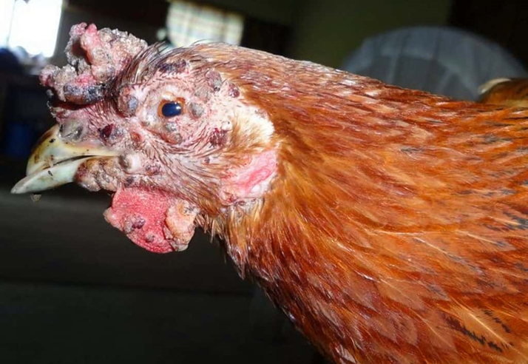
Clinical signs:
There are three forms of the disease :.
1- Skin form : Dry pox ( Cutaneous form ): Shows wart- like lesions on the comb, wattles, eyelids and other unfeathered parts of the body .It starts as whitish foci which develops into nodules,then sloughed and scab appear before final healing .

Slide 5
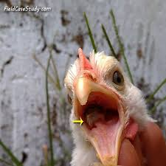
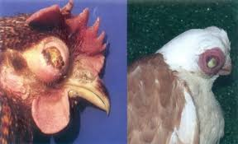
2-Diphtheritic type: Wet pox .Yellow patches on the surface epithelium of mouth , larynx ,trachea and esophagus. Removing of these lesions left eroded or ulcerated area.
3-Coryza –like form : Infection of the nasal chambers
accompanied by Coryza-like signs

Slide 6
Differential diagnosis
Vitamin A deficiency.
Infectious Coryza.
Infectious Bronchitis.
Infectious Laryngotracheitis.
Mycoplasmosis.
Newcastle Disease ( Respiratory form)
Aspergillosis
Airsacculitis.
Avian Influenza ( Respiratory signs )
Trichomoniasis.
Physical damage.

Slide 7
Diagnosis:
Typical lesions .
Histopathology : Intra-cytoplasmic inclusions with ballooning degeneration.
Viral isolation.
Experimental infection.

Slide 8
Treatment: No treatment. Removal of scabs around the eyes or mouth will facilitate eating or drinking. topical care of the lesions, usually with an iodine solution. Antibacterial treatment may also be incorporated to fight off bacterial infections.
Prevention:
Vaccination.
A-Fowl poxvirus vaccine : More virulent.
B- Pigeon poxvirus vaccine : Less virulent
2. Both vaccines are given via the wing-web .

Slide 9
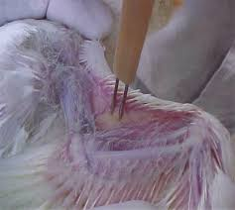
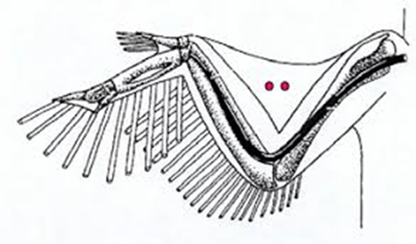
Types of Fowl Poxvirus Vaccines:
Live Attenuated Vaccines
Derived from weakened fowl poxvirus strains.
Provides long-term immunity after a single dose.
Typically applied using the wing-web method.
Recombinant Vaccines
Uses viral vectors like fowlpox virus carrying genes for other poultry pathogens (e.g., Newcastle disease).
Provides protection against multiple diseases.
Vaccination Methods:
Wing-Web Stab Method (common in chickens)
A two-pronged needle is dipped in the vaccine and inserted into the wing web.
A small scab forms at the site, confirming successful vaccination.
Feather-Follicle or Skin Scarification (used in some settings)
The vaccine is applied by scratching the skin to introduce the virus.

Slide 10
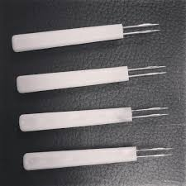
Vaccination Schedule:
Chickens: 6–8 weeks of age (single dose)
Turkeys: 8–12 weeks of age
Boosters may be needed in endemic areas.
Post-Vaccination Signs:
Mild localized swelling or scab formation.
Immunity develops within 10–14 days.
Importance of Vaccination:
Prevents severe outbreaks, especially in high-density poultry farms.
Protects against diphtheritic (wet) fowl pox, which affects the respiratory system.
Reduces economic losses in commercial poultry production.

Slide 11
Egg Drop Syndrome ₇₆(EDS₇₆)
Is sudden drop in egg production or failure to achieve normal peak in production.
IMPORTANCE: EDS76 is viral disease characterized by decrease in egg production, reduction in egg quality as well as the birds do not become ill.
Etiology : Duck Adenovirus A.
Transmission :
Vertical transmission, both interior and exterior of the egg contain virus.
Lateral transmission : a. From bird to bird ( slow).
b. Contamination of egg trays .
c. Wildfowl and biting insects.

Slide 12
:Clinical signs
The disease has been reported in chickens and quail.
1-Eggs drop at peak or failure to peak.
Drop may be of 10 _ 40 % and last for 4_10 weeks.
2- Rough (chalky) , thin or soft-shelled eggs and shell-less eggs.
3-Loss of shell pigment.
4-Poor internal quality.
5-Lack of signs in the birds themselves.
6- Mortality is usually negligible.

Slide 13
:Post-mortem lesions
No specific lesions, the lesions are minimal and are confined to the reproductive tract of hens , there may be inactive ovaries , atrophy of oviducts and edema and white exudates in the uterus.
Histopathology :
Histopathological changes can be seen in the oviduct. Severe degeneration and desquamation of the epithelial cells , atrophy of uterine glands, infiltration of inflammatory cells, and intranuclear inclusion bodies .

Slide 14
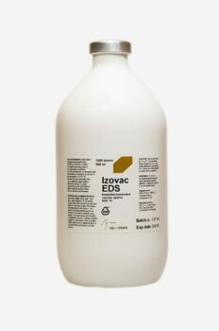
:Diagnosis History : Healthy flock. Lesions. Isolation of adenovirus. Serology: HI , ELISA.

Slide 15
:Differential diagnosis
1- Management problems: Inadequate water supply, high temperature, inadequate lighting program, sudden changes of feed.
2- Nutritional deficiency : Specifically vitamins E, B12 and D as well as calcium , phosphorus , selenium.

Slide 16
3-Infectious diseases : Include Infectious Bronchitis, Infectious Laryngotracheitis, Avian Encephalomyelitis, Newcastle Disease ,Marek’s Disease and Leukosis or any infectious disease (CRD, Infectious Coryza, Cholera, Parasites , Fowl Pox,) 4- Metabolic diseases : Include Fatty Liver Syndrome , intoxication by sulphonamides , insecticides .

Slide 17
1. Types of EDS Vaccines
There are two main types of vaccines used for EDS prevention:
a. Inactivated (Killed) EDS Vaccines
Contains inactivated Duck Adenovirus A mixed with an oil-based adjuvant.
Provides strong immunity when given before the laying period.
No risk of viral shedding or transmission.
b. Live Attenuated EDS Vaccines (Less Common)
Rarely used due to concerns about viral persistence.
Some experimental vaccines exist but are not widely commercialized.

